Slide 1
Shoring vs. Shielding
Shoring
Shielding
Definition: means a structure such as a metal hydraulic, mechanical or timber shoring system that supports the sides of an excavation and which is designed to prevent cave-ins.
Examples: Vertical Hydraulic Shores, Manhole Braces, Walers, Hydraulic Aluminum Trench Boxes, End Shores, Slide Rail, Hydraulic Bracing, and many forms of Site Specific Engineered Solutions.
Uses: Shoring applications have many uses.
  Protection of workers by preventing cave-ins
  Support surrounding area surface encumbrances and adjacent structures
  Increase production and reduce costs vs. sloping or benching excavations or trenches
Definition: means a structure that is able to withstand the forces imposed on it by a cave-in and thereby protect the employees within the structure. Shields can be permanent structures or can be designed to be portable and moved along as work progresses.
Examples: Steel Trench Boxes, Aluminum Trench Boxes, Build A Boxes or Modular Aluminum Panel Shields (MAPS), Manhole Boxes, Pit Boxes, and Steel Wrapped Aluminum Boxes
Uses: Shielding applications usually consist with two goals in mind.
  Protection of workers from the effects of cave-ins.
  Increase production and reduce costs vs. sloping or benching excavations or trenches

Slide 2
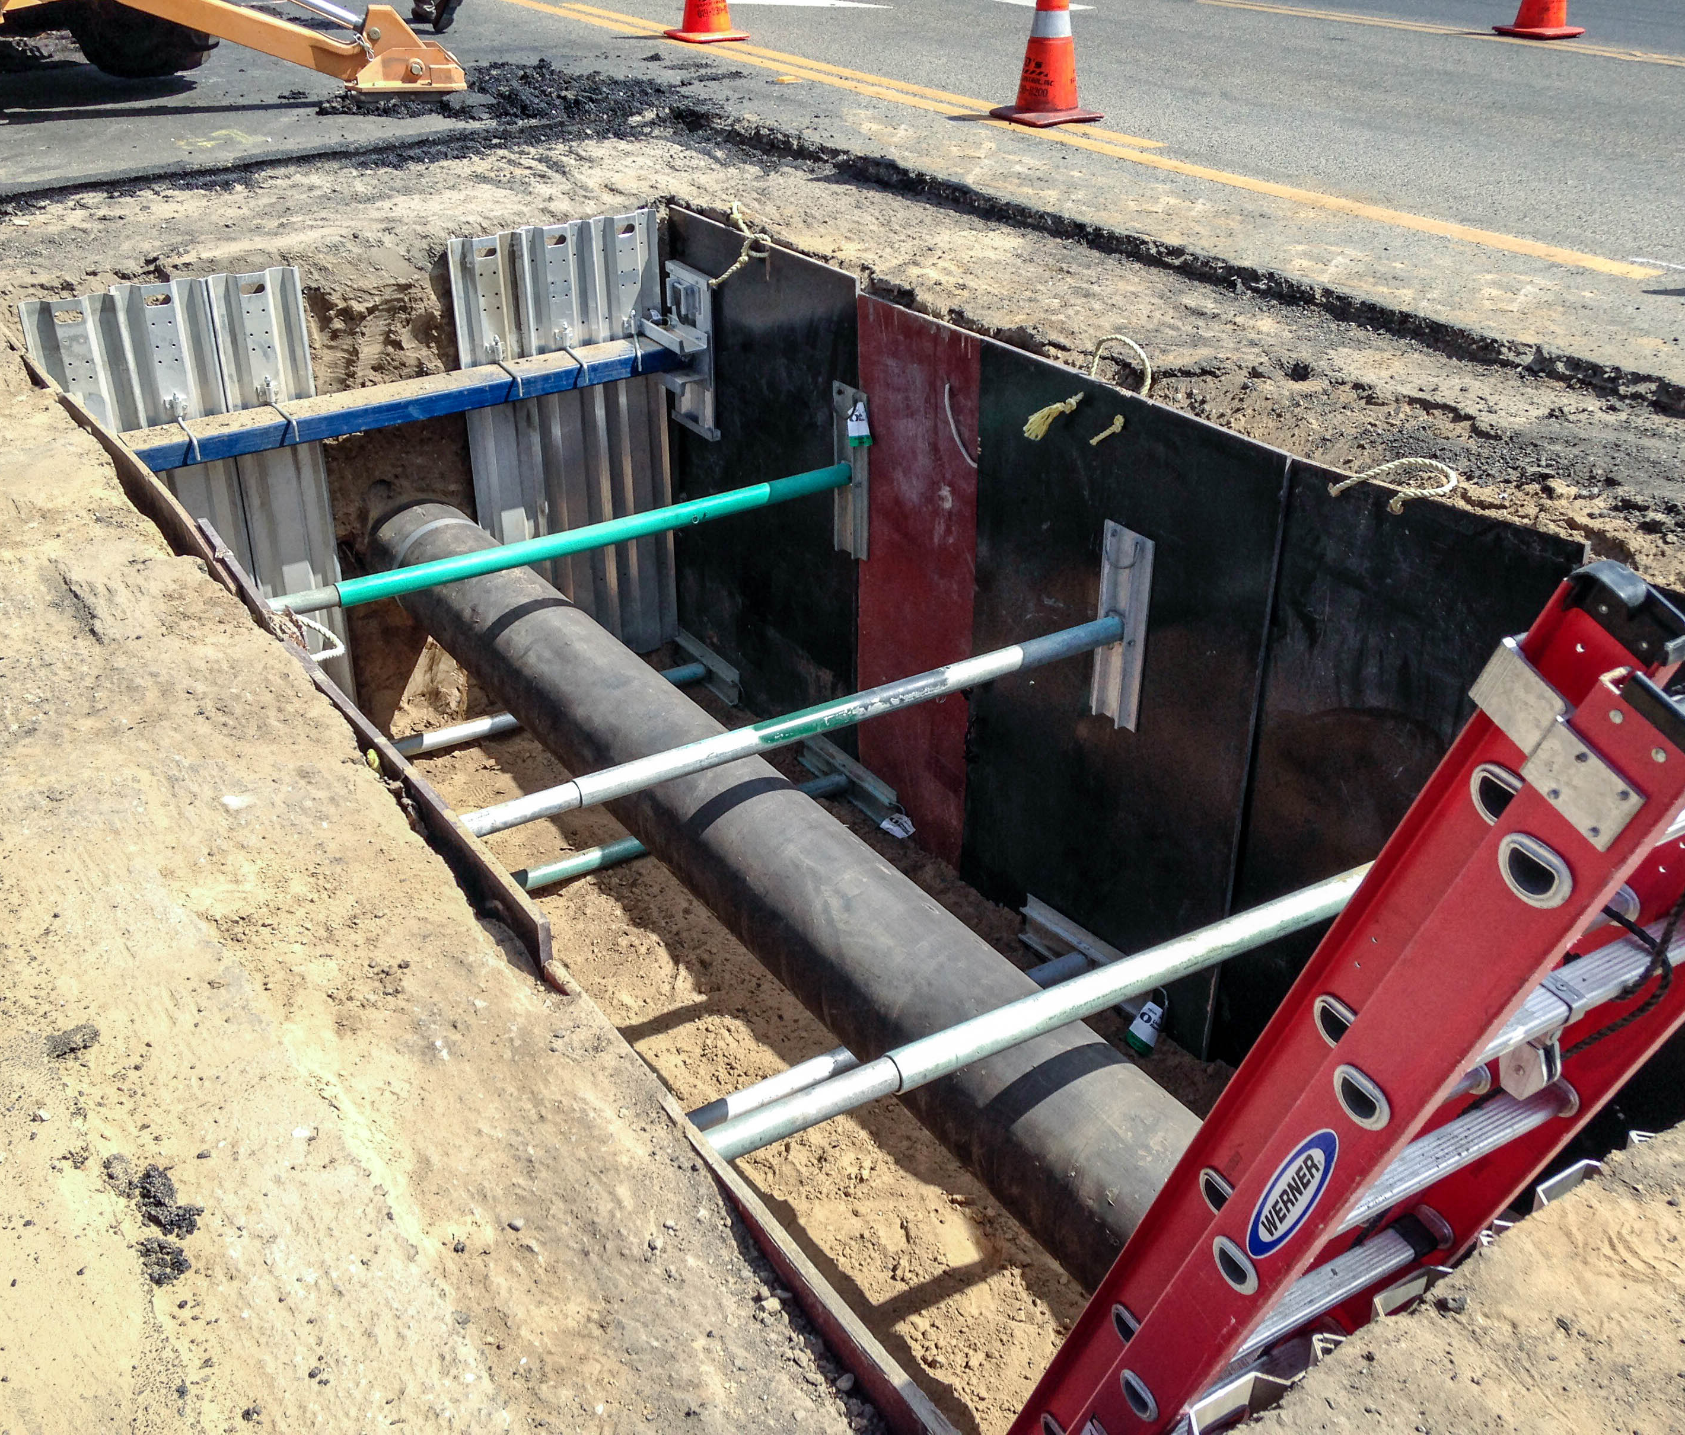
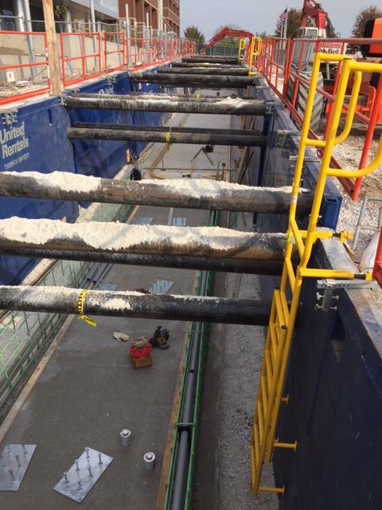
Prevention or Protection?
Shoring
Shielding
Supports the sides of an excavation and is designed to
prevent cave-ins
Designed to withstand forces imposed on it by a cave-in
and protect employees within the shield

