Slide 1
5-STEP GEN Z AND MILLENNIAL DIGITAL BRANDING BREAKTHROUGH REVIEW
MAY 2018
OF SELECTED DCA MEMBERS’ WEBSITES AND JOB SEEKER / APPLICANT PATHWAYS

Slide 2
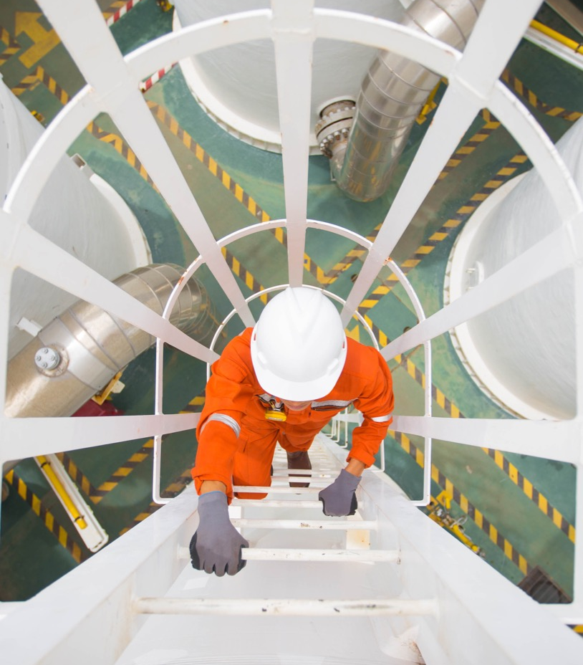
OVERVIEW
The Center for Generational Kinetics (The Center) implemented an in-depth review of Distribution Contractor Association’s (DCA) selected members’ websites and social media.
The goal was to identify what is working well, what can quickly be strengthened, and actions to take to drive online job interest and applications for its member companies with potential Gen Z and Millennial employees.

Slide 3
HIGH-ROI GOALS
OF THE GEN Z AND MILLENNIAL DIGITAL BRAND BREAKTHROUGH REVIEW
Reveal
how Gen Z and Millennials view and engage with DCA member companies on their individual websites and across social media channels using The Center’s unique Generational Context™ review approach.
Identify
specific areas for immediate recruiting wins and strategic actions that can be used to drive greater Gen Z and Millennial online job applications to DCA members.

Slide 4
TABLE OF CONTENTS
PAGE
08
WEBSITE BEST PRACTICES
WEBSITE: JOB SEEKER AND APPLICANT PATHWAY
SOCIAL MEDIA: OVERALL BEST PRACTICES
SOCIAL MEDIA: JOB SEEKER AND APPLICANT PATHWAY
3-PHASE RECRUITING ACTION PLAN RECOMMENDATIONS
NEXT STEPS
Q&A WITH THE CENTER’S TEAM
PAGE
56
PAGE
24
PAGE
61
PAGE
PAGE
62
35
PAGE
48

Slide 5
DCA MEMBERS FACE
A GROWING GENERATIONAL CHALLENGE WITH GEN Z AND MILLENNIAL JOB SEEKERS
The distribution contractor industry has a tremendous legacy, experienced leaders, and immediate opportunities for dramatic growth—if it can hire the people the industry needs.
The challenge is that the industry has been unable to meet its Gen Z and Millennial employment recruiting and hiring needs. This has limited the industry’s revenue growth and delayed attracting and developing its next generation of leaders in adequate numbers.
Each DCA member company must begin a digital recruiting transformation will determine the future of its workforce starting today.

Slide 6
DISCOVERING
THE HIDDEN GENERATIONAL OPPORTUNITY
If DCA member companies use the insights, observations, and suggestions in this review findings deck, they will be able to tap into two huge generations that can drive the growth of the industry for decades to come: Gen Z and Millennials.
The key is being open to these new ideas and taking the right digital actions to adapt, recruit, and win these two generations of potential employees. Each member company does not need to implement everything in the review at once, but selecting one, two, or three actions to take right away can put the company on a path to solving its recruiting needs.
We recommend sharing these findings with key stakeholders in your company to create a custom action plan that can be implemented over 90, 180, and 365 days.

Slide 7
THE CENTER’S 5-STEP
GEN Z AND MILLENNIAL DIGITAL BRAND BREAKTHROUGH REVIEW
The Center’s review team consisted of researchers, marketers, strategists, and a behavioral designer. The team implemented The Center’s unique 5-Step Gen Z and Millennial Digital Brand Breakthrough Review, which includes:
STEP TWO: Website Job Seeker and Applicant Pathway
STEP FOUR: Social Media Job Seeker and Applicant Pathway
STEP ONE: Website Review
STEP THREE: Social Media Review
STEP FIVE: 3-Phase Recruiting Action Plan

Slide 8
Website | BEST PRACTICES
TO ALIGN WITH THE MILLENNIAL AND GEN Z WORLDVIEW & ON-SCREEN MESSAGING HIERARCHY

Slide 9
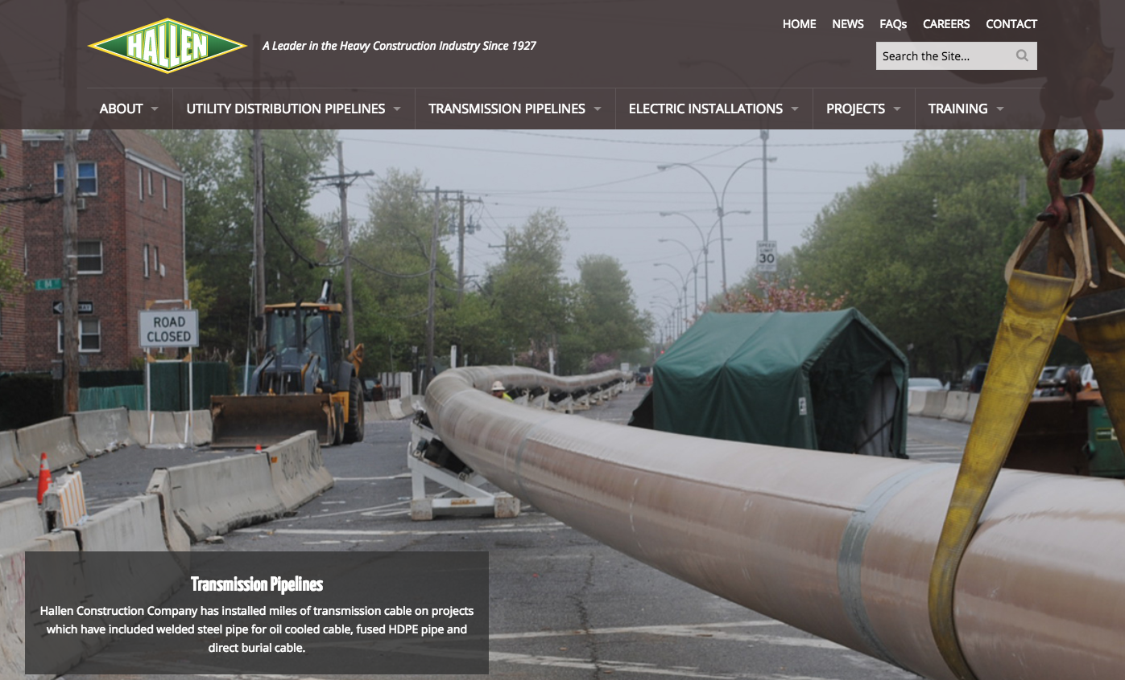
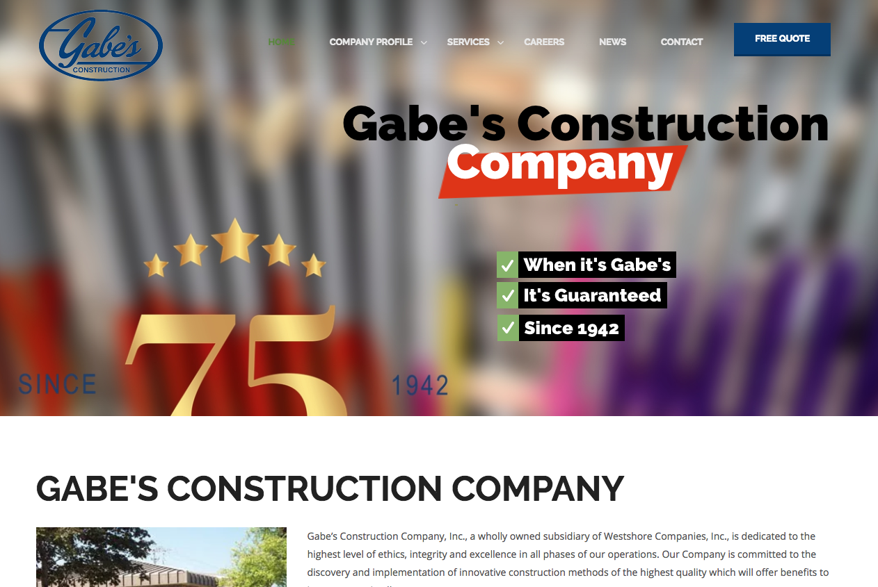
WEBSITES REVIEWED
https://www.millerpipeline.com/
http://www.infrasourceus.com/
https://gonpl.com/
http://www.hallenconstruction.net/pages/index.php
http://www.ellingsoncompanies.com/our-services/trenchless-solutions/
http://q3contracting.com/
http://gabes.com/
http://www.alexparis.com/default.htm

Slide 10
WHAT ARE WEBSITE BEST PRACTICES
FOR GEN Z AND MILLENNIALS?
CALL TO ACTION: Do Millennials and Gen Z know where to go first on each page? Is there a clear and compelling call to action for them?
USE OF HIGH RESOLUTION PHOTOS AND VIDEO: Are images and videos used to communicate the company’s brand and do they align with Gen Z and Millennials’ life goals and expectations for diversity?
01
04
COMPELLING COMPANY BRAND: Do Millennials and Gen Z immediately get a strong feeling for what the company brand stands for or what makes the company unique?
02
MINIMUM TEXT: Is text offset with bullets and icons? Is it easy to find information using buttons instead of drop-down menus?
05
PHOTOS REFLECT THE AUDIENCE: Do Gen Z and Millennials see people who look like them on the website and on leadership pathways within the company?
MOBILE: Is the company website easy-to-use on both laptop and mobile screens of different sizes?
03
06

Slide 11
WHAT IS ONSCREEN MESSAGING HIERARCHY?
INFORMATION IS EASY TO FIND: Do Gen Z and Millennials quickly see where to go for help or questions? For recruiting - can they quickly apply for a job?
HIGH IMPORTANCE GETS HIGH POSITION ON THE PAGE: Are the most important calls to action or information positioned at the top of web pages to gain the most attention?
VISUALS TELL THE STORY: Are persuasive visuals elements used to reinforce the key message? For recruiting – are visuals tied to employment branding and each “next step” in the job application pathway?
VIDEOS ENGAGE THE VISITOR: Are valuable resources offered like a video tour of your company or information about on the job training? For recruiting – Do videos show what it is really like to work at your company?

Slide 12
WHAT IS THE GEN Z AND MILLENNIAL WORLDVIEW?
AGE: The oldest members of Gen Z are now ages 18–21, entering the workforce in large numbers, and driving all emerging digital recruiting and job applicant trends.
Millennials are currently ages 22 to 40. Their age range covers most of the key markers of adulthood, from professional career entry to marriage, kids, buying a home, and more (but all of the above are happening later in life than previous generations)
DIVERSITY: Gen Z and Millennials are the most diverse generations in modern history, but also the most consistent generation globally.
UNIQUENESS: Gen Z and Millennials expect career pathways that fit their uniqueness and potential, so adopt the best tagline The Center has discovered for them: “Careers as unique as you are.”

Slide 13
WHAT IS THE GEN Z AND MILLENNIAL WORLDVIEW?
TECHNICALLY FLUENT: Gen Z and Millennials have the highest expectations of any previous generations for technology integration in the workforce, from recruiting and applying to communication, learning, collaboration, and problem solving.
VALUE COMMUNITY: Gen Z and Millennials both want to work for an employer that is perceived as stable and has a commitment to its people and the communities it serves.
WANT CLEAR CAREER PATHWAYS: Gen Z and Millennials do not view technology as an addition to the career experience, but a key link for their entire employment and career journey.

Slide 14
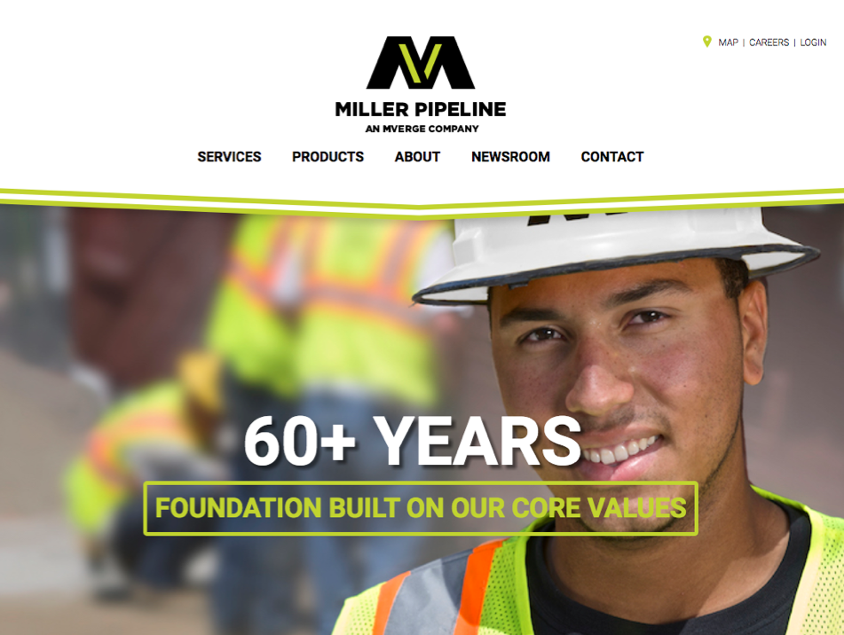
BEST PRACTICES
TO ALIGN WITH THE MILLENNIAL AND GEN Z WORLDVIEW & ON-SCREEN MESSAGING HIERARCHY
SUCCESSES: Photos Reflect the Audience
Great high-resolution photo of smiling Millennial on the homepage
EVEN BETTER IF:
The white text read: “60+ Years of Building Great Careers”
The green box was a scroll over button that read: “Join Our Team. Click to Apply Now.”

Slide 15
BEST PRACTICES
TO ALIGN WITH THE MILLENNIAL AND GEN Z WORLDVIEW & ON-SCREEN MESSAGING HIERARCHY
SUCCESSES: Compelling Company Brand
Strong brand tag line: “Building infrastructure; Building relationships”
EVEN BETTER IF:
The tag line was job seeker focused: “Building infrastructure; Building careers” or “We build infrastructure; We build relationships”

Slide 16
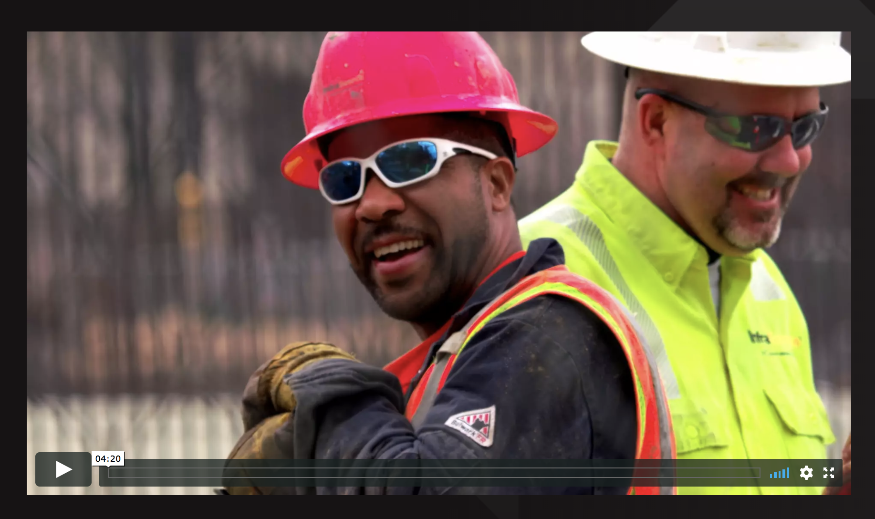
BEST PRACTICES
TO ALIGN WITH THE MILLENNIAL AND GEN Z WORLDVIEW & ON-SCREEN MESSAGING HIERARCHY
SUCCESSES: Videos Engage the Visitor
Some of the DCA member companies have videos featuring employees talking about their experiences.
EVEN BETTER IF:
The video was shorter (one to two minutes) to match the Gen Z and Millennial job seeker attention span. Gen Z and Millennials will spend more time on your website watching videos than reading long blocks of text.

Slide 17
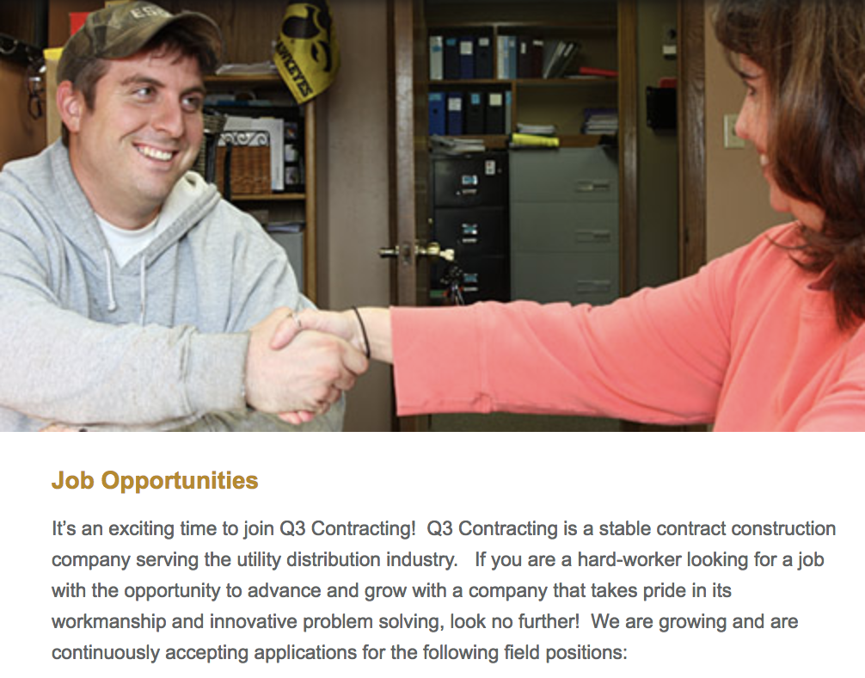
BEST PRACTICES
TO ALIGN WITH THE MILLENNIAL AND GEN Z WORLDVIEW & ON-SCREEN MESSAGING HIERARCHY
SUCCESSES: Visuals Tell the Story
One DCA member used photos of current, Millennial employees on its career page.
EVEN BETTER IF:
Websites showed more photos of Gen Z and Millennial employees to represent more diversity. Keep in mind that this is the most diverse generation in history. Embracing this diversity gives you an advantage in recruiting.

Slide 18
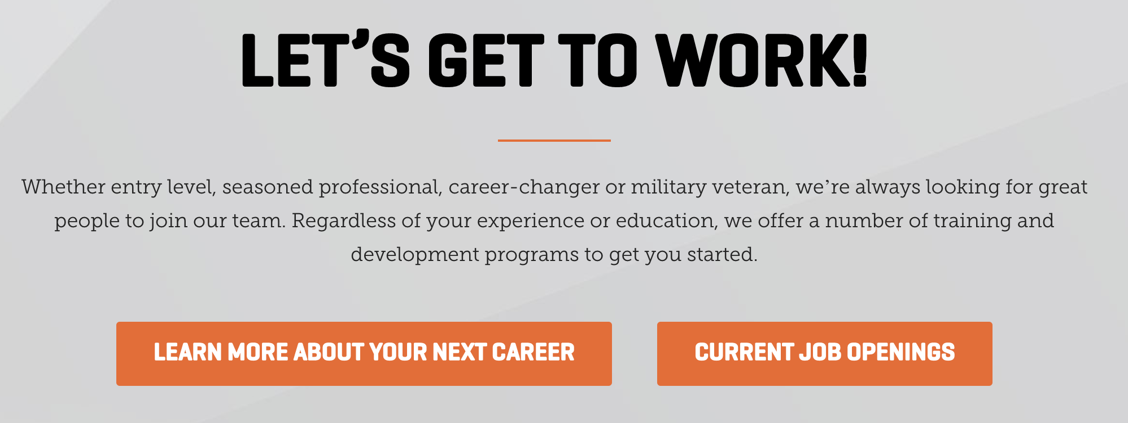
BEST PRACTICES
TO ALIGN WITH THE MILLENNIAL AND GEN Z WORLDVIEW & ON-SCREEN MESSAGING HIERARCHY
SUCCESSES: Call to Action
Great call to action (CTA) “Learn more about your next career”
EVEN BETTER IF:
It was located on the front page
Change the text from “Let’s Get to Work” to “Let’s Work Together!”

Slide 19
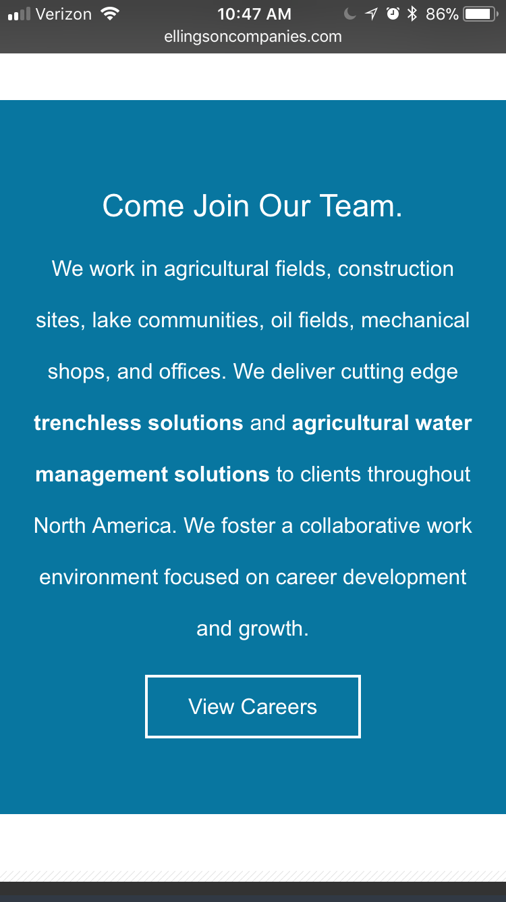
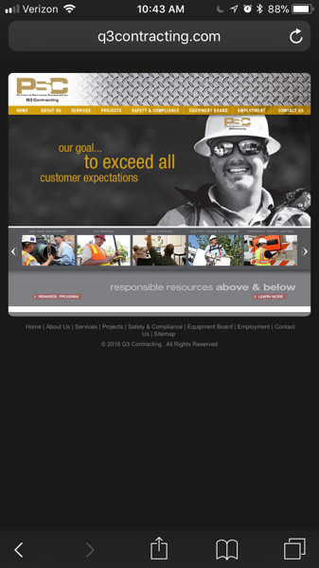
AREAS TO IMPROVE
Websites Need to Work on Mobile: Only two websites reviewed were fully mobile responsive (the website presents itself differently on a smaller screen so it’s easy to use – and does so without you having to download an app).
Gen Z and Millennials spend a majority of their time on their mobile devices. This means your website must be easy to view and engage with on mobile devices as well as traditional computer screens. Test your site today. If it’s not easy to use on a mobile device than it needs to be updated asap.
“Let’s check now if you company’s website is mobile friendly” (phone activity here)

Slide 20
AREAS TO IMPROVE
Clear Call to Action: Website visitors need to know what actions to take first on the home page.
Mobile Friendly: Build the website to be responsive to varying mobile screen sizes.
Gen Z and Millennial Images: Gen Z and Millennials need to see pictures of employees their age in roles from entry-level to a leadership pathway.
Add Videos to Increase Engagement: Short Gen Z and Millennial friendly videos will increase the amount of time job seekers spend on your website.
Make Navigation Easy to Use: Don’t hide important pages in drop-down menus. Whenever possible, make one-click options clear and easy from the homepage. Example: Find your next job
Make Pages Easy to Scan: Large blocks of text can be difficult to read on mobile and are frequently skipped by Millennials and Gen Z. Instead use bullet points, videos, and headers to make a page easy to scan at a glance.

Slide 21
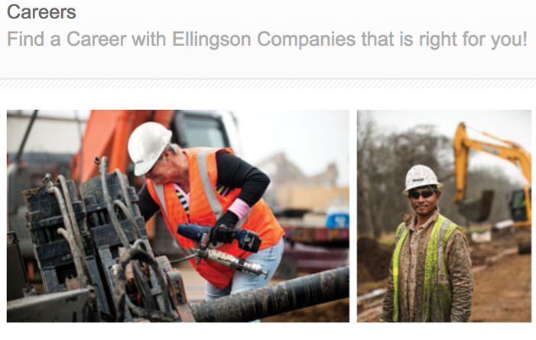
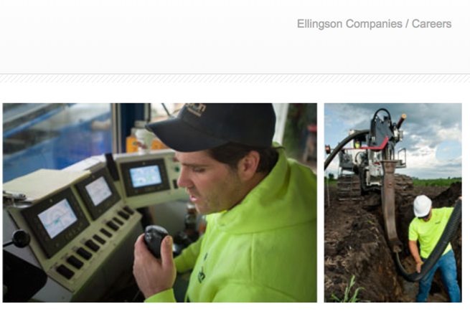
SPECIFIC SOLUTIONS
Showcase Action, Diversity, and Being on The Frontlines of Making an Impact in Images and Videos
Add visuals of Gen Z and Millennial employees. The photos should not appear to be stock photos or “staged.” Gen Z and Millennials want to see what it is really like working for you on the "frontlines.”
Include ethnic diversity, and a variety of settings, activities, and experiences. A best practice strategy is to use more pictures of people rather than equipment.

Slide 22
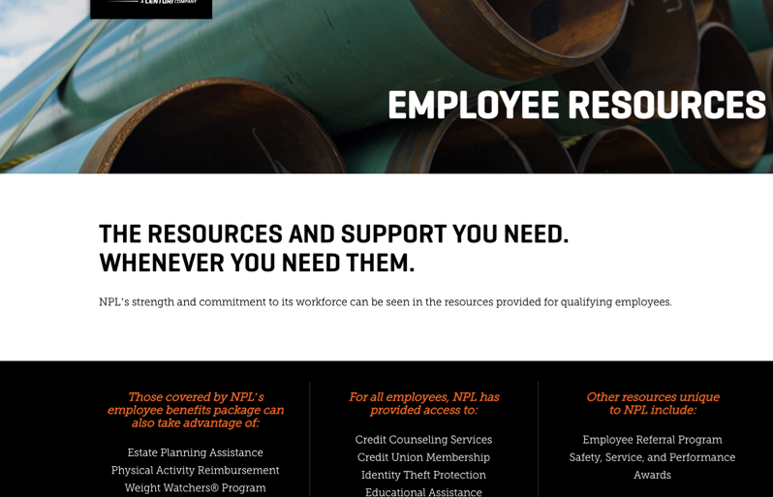
SPECIFIC SOLUTIONS
Include Information Gen Z and Millennials Want to Know on Your Careers Pages
Design and implement a strategic generational content plan targeted at job seekers ages 18 to 40, with an emphasis on 18 to 25 who might be entirely new to the industry. Consider core content pieces such as: 5 Things to Know about Our Industry, 7 Things to Know About Our Company, and titles such as: How Fast You Can Get Promoted, etc.
Offer a range of resources to website visitors. Gen Z and Millennials prefer online content that is specific to solving a problem or answering a question they have. An FAQ page or series of blog posts about what it is like to work at your company would be ideal, especially a behind the scenes or “day in the life of” with someone their age.

Slide 23
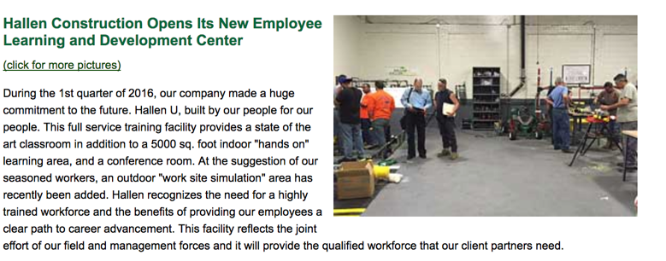
SPECIFIC SOLUTIONS
Create Clear Navigation
Make it easy for Gen Z and Millennials to find where they want to go on the site. Link to employment or career landing pages with an engaging call to action button rather than drop-down menus.
Create progress bars for key recruiting outcomes, such as applying for a job (ex: Domino’s pizza tracker or Amazon order tracking)
Highlight Call to Action: Use contrasting colors to highlight exactly where the company wants Gen Z and Millennials to look on each page. One way to think about it: What is most important for job seekers to read or do (CTA) on this web page? That is what should stand out.
Break Up Blocks of Text: Add visuals, icons, graphics, and 3 to 5 bullet points to break up heavy text areas into content that is more engaging and welcoming.

Slide 24
Website | GEN Z AND MILLENNIAL
JOB SEEKER AND APPLICANT PATHWAY

Slide 25
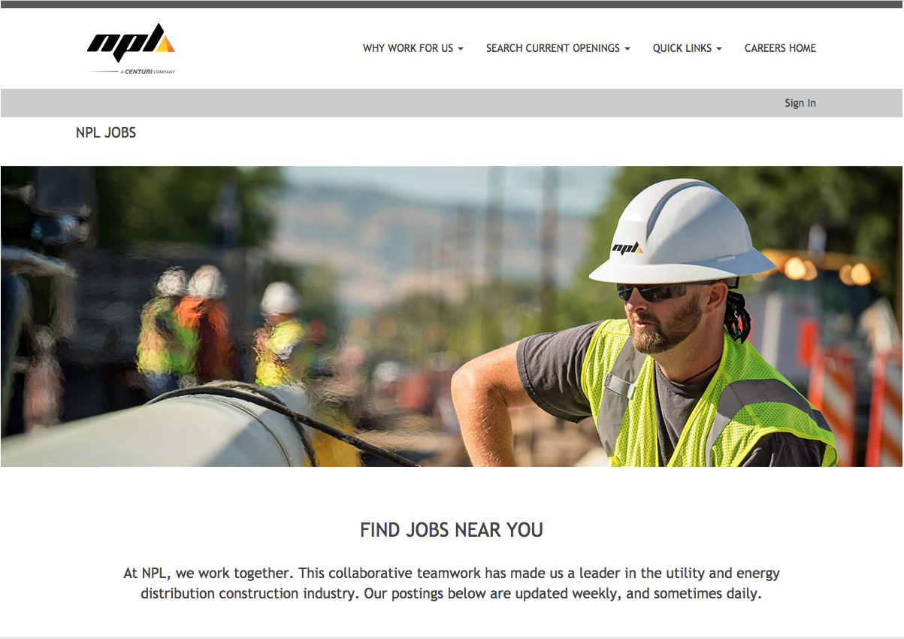
WEBSITES REVIEWED
https://www.millerpipeline.com/careers/
http://www.infrasourceus.com/careers
https://jobs.nextcenturi.com/NPL/go/NPL-JOBS/3558600/
http://www.ellingsoncompanies.com/careers/
http://q3contracting.com/employment/postings
http://gabes.com/careers
http://www.alexparis.com/employment.htm

Slide 26
SAMPLE CONSIDERATIONS
CALL TO ACTION (CTA): Is the call to action to apply clear and prominent on the home page?
01
04
EMPLOYER REVIEWS: Can a potential Gen Z or Millennial applicant easily find employer reviews?
05
EASY APPLY ON ALL DEVICES: Can a job seeker apply on your website via laptop and mobile?
CTA VISUAL AMPLIFICATION: Is the call-to-action amplified by an icon, button or other attention focusing visual?
02
06
FAST APPLICATION : Can a Gen Z or Millennial job seeker start an application and set up an account in 60 seconds or less?
EMPLOYMENT BRAND PROMISE: How is your company employment brand and employment promise being communicated in job postings listed on your site and on other websites?
ACKNOWLEDGEMENT: Does the applicant receive an acknowledgement and next steps message from your company once the application is submitted?
03
07

Slide 27
GEN Z AND MILLENNIAL
JOB SEEKER AND APPLICANT PATHWAY
SUCCESSES: Employment Brand Promise
The heading is strong and explains how the job aligns with their worldview.
EVEN BETTER IF:
There was a call to action at the end that said “Join us. Build your career here.”

Slide 28
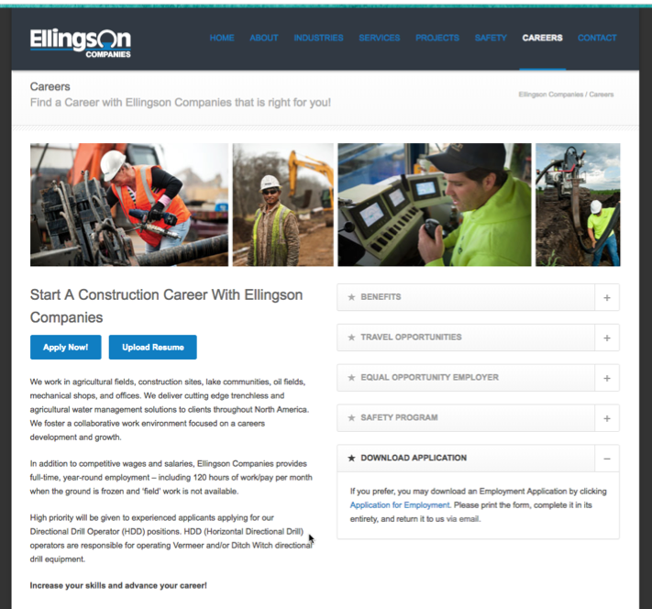
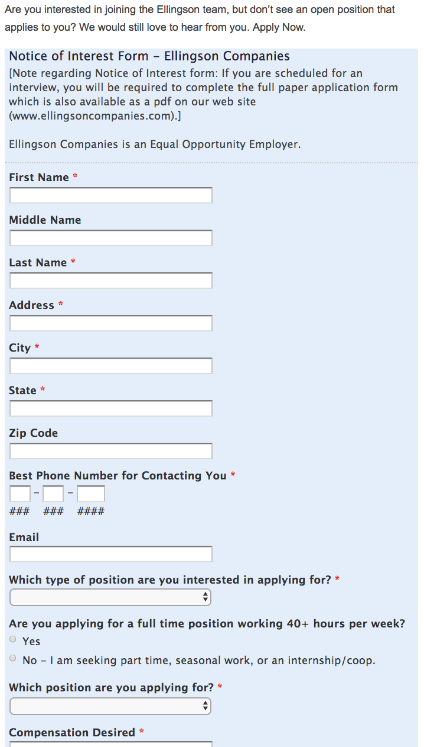
GEN Z AND MILLENNIAL
JOB SEEKER AND APPLICANT PATHWAY
SUCCESSES: CTA Visual Amplification
A Gen Z or Millennial job seeker can easily click the blue button to apply.
EVEN BETTER IF:
Once you get to the next page, the form is shorter and requires less information to start the application process.

Slide 29
GEN Z AND MILLENNIAL
JOB SEEKER AND APPLICANT PATHWAY
SUCCESSES: Employment Brand Promise
Here are examples from two member companies that used Gen Z and Millennial focused language on their careers pages.
“If you are a hard-worker looking for a job with the opportunity to advance and grow with a company that takes pride in its workmanship and innovative problem solving, look no further!”
“If you're ready for a challenging job at a company that rewards fresh ideas and a positive attitude, InfraSource is the place for you.”
EVEN BETTER IF:
The messaging ties into helping the community or making a difference. The sentences were shorter in length.
“HELP BUILD AND GROW OUR COMMUNITIES — ONE PROJECT AT A TIME.”

Slide 30
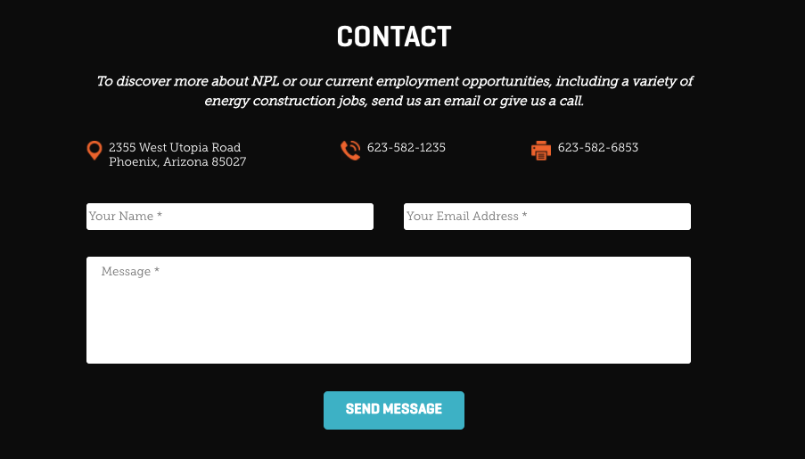
AREAS TO IMPROVE
GEN Z AND MILLENNIAL JOB SEEKER AND APPLICANT PATHWAY
Difficult to Apply: It was difficult to apply for a job on every website we visited. On a mobile screen applying was even more difficult.
Contact pages were also hard to use on a mobile because they were not mobile friendly.
Millennial and Gen Z job seekers need an easy way to apply for a job, request more information about a job, and send messages via a company’s website, especially on mobile devices. Consider testing a live chat service which will be a very small cost yet provide much higher engagement with potential applicants.
Even better if the text options and social media buttons were available at the top of all webpages since Millennials and Gen Z prefer these to a fax machine!

Slide 31
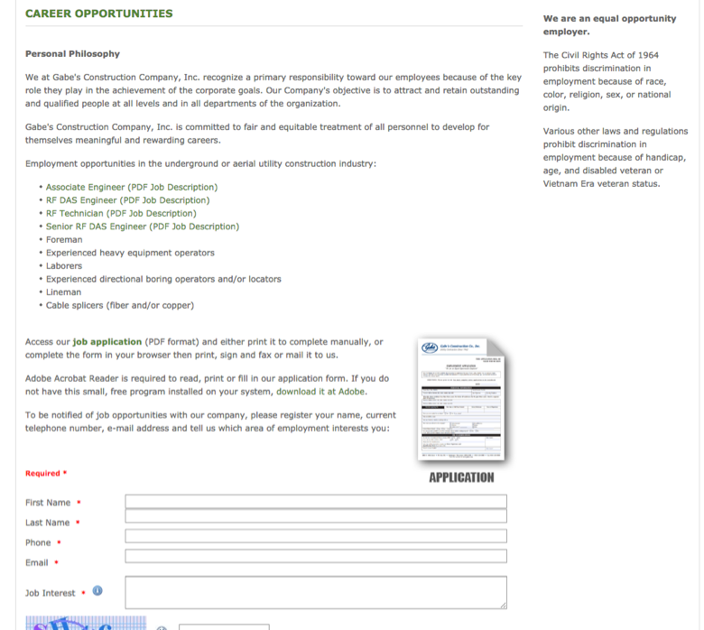
AREAS TO IMPROVE
GEN Z AND MILLENNIAL JOB SEEKER AND APPLICANT PATHWAY
Long Applications: Many applications were 5 to 8 pages when printed. While that may be required for the position, make the first step of the application much shorter, such as 2 pages or less.
This enables them to be added to your system and move to the second step, which includes the more in-depth application components.
By setting them up in the system first, you can choose to re-engage them if they don’t complete the application.

Slide 32
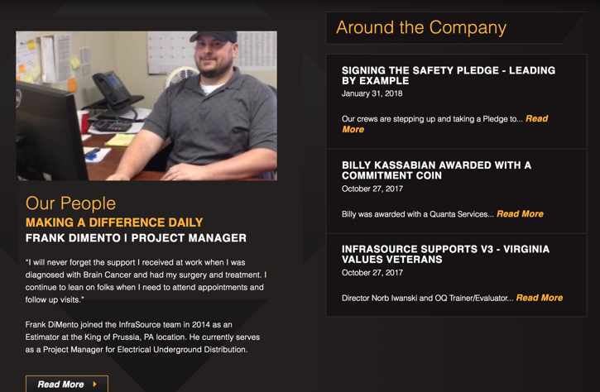
AREAS TO IMPROVE
GEN Z AND MILLENNIAL JOB SEEKER AND APPLICANT PATHWAY
Lack of Employee Testimonials: Few employee reviews or testimonials were found on DCA member websites. This is an immediate opportunity to drive more excitement about working in the industry because Gen Z and Millennials use testimonials from current employees to make job application decisions.
Request and then add employee testimonials to your website and feature them on the homepage and prominently on your Careers page.
Highlight employee stories, promotions, workplace successes, and volunteering in the community. These stories “humanize” your digital recruiting experience with Millennials and Gen Z, which will lead to more interest and applicants.

Slide 33
SPECIFIC SOLUTIONS
EMPHASIZE YOUR UNIQUE EMPLOYMENT BRAND ON YOUR HOMEPAGE
Add Bolded Employment Brand Tagline: “Come build great things with us” or an employment brand tag line that clearly tells why your company is different than the rest on the Homepage. Ex: “Great people solving tough challenges”
Message Your Unique Employment Brand on the Home Page: It should be prominent. Anything that makes you different from other employers in your area will help, including your company culture, employee benefits, training, history, and company vision.
Directly Answer the Questions: “Why should job seekers apply right now? What makes your company unique? What about your company makes a job seeker want to tell their friends they should apply, too?”

Slide 34
SPECIFIC SOLUTIONS
MAKE IT COMPELLING, QUICK, AND EASY TO APPLY
Reduce text on pages — Add images, icons and videos instead. In general, DCA member sites rely too heavily on text. Gen Z and Millennials skip text blocks in favor of photos, videos, bullet points, and graphics. Incorporate more of these into each page to increase job applicants.
A job seeker should be able to learn about job requirements, salary ranges, benefits, and other key employment insights easily. On every page where you have this information include a video about your company’s culture or mission, or you can include a video or photos with current Gen Z and Millennial employees.
Add clear “APPLY NOW” call to action on Home page: Many websites were missing a clear call to action to drive Gen Z and Millennials to an application or application page. It is ideal if they can apply for many jobs at once.
Shorten time to apply: Shorten the time required to start the application process. Gen Z and Millennials may complete an application over a few different time periods. The key is to make the first step to applying fast and easy. This will not only drive more application starts and completions, but also enable you to re-engage those who started but did not finish completing an application.
Make it easy to apply on a mobile phone: Reduce the number of clicks needed to apply on a mobile device to as few as possible. Test your job application form and experience on at least 5 different mobile and tablet devices.
Focus on making the digital experience on mobile easy to use. Gen Z and Millennial job seekers expect the fewest numbers of scrolls, taps and typing to find the information they want and begin the application process. Make it easier and you’ll get more applicants.

Slide 35
Social Media | BEST PRACTICES
FOR ENGAGING GEN Z AND MILLENNIALS

Slide 36
SOCIAL MEDIA LINKS WE REVIEWED
https://www.linkedin.com/company/miller-pipeline/
https://www.facebook.com/Miller-Pipeline-124303277588602/
https://www.linkedin.com/company/infrasource/
https://www.facebook.com/NPL-Construction-Co-980262232085713/
https://www.linkedin.com/company/npl-construction-co-/
https://www.linkedin.com/company/the-hallen-construction-co-inc/
https://www.facebook.com/ellingsoncompanies/
https://www.linkedin.com/company/ellingson-companies/
https://www.facebook.com/Gabes-Construction-Co-Inc-202107646492046/
https://www.linkedin.com/company/gabe%27s-construction-co-inc-/
https://www.facebook.com/pages/Alex-E-Paris-Contracting/157484857619318

Slide 37
SAMPLE CONSIDERATIONS
REINFORCE EMPLOYMENT BRAND: Does social media reinforce the company’s employment brand promise and credibility? Do Gen Z and Millennials get a strong feeling for the employment brand through a compelling mix of content?
EMPLOYER RATINGS AND REVIEWS: Are employer ratings and reviews included in the digital experience? Are negative comments or reviews responded to in a professional and empathetic manner?
01
03
DIVERSE IMAGES AND VIDEOS: Can Gen Z and Millennials easily envision themselves as a company employee? Are diverse images, visuals, and videos of Gen Z and Millennials used consistently?
BRAND CONSISTENCY: Is employment brand messaging consistent across all channels? Is it easy to find each social media channel from the primary website?
02
04

Slide 38
WHAT ARE SOCIAL MEDIA BEST PRACTICES
FOR GEN Z AND MILLENNIALS?
Consistently and positively messaging your employment brand – including employees, leadership, culture, volunteering, more on social media is a must-have for attracting Gen Z and Millennial job seekers. This can also have the added benefit of increasing engagement with current employees, making it easier for them to show what makes your company a great place to work.
Why?
Millennials and Gen Z spend much of their time doing job search research online. Social media is where they go to see what a company "is really like" through the vantage point of employees, customers, and employers.
Social media is a key recruiting pathway for Millennials and Gen Z

Slide 39
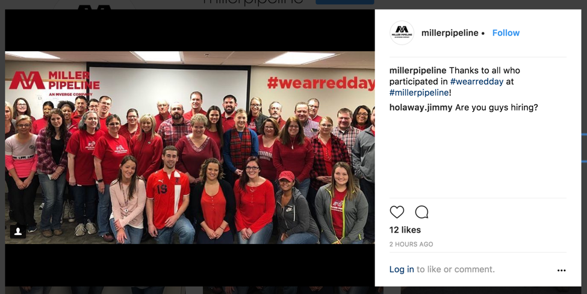
WHAT ARE SOCIAL MEDIA BEST PRACTICES
FOR GEN Z AND MILLENNIALS?
The Best Posts to Share: Content generated by your current Millennial and Gen Z employees.
Let your current team members and internal fans take photos, record a short video, or capture their team doing something great in the community or as part of your culture.
These homemade style posts—still posted and approved by you—are the best social media you can have to attract job seekers.
INSIDER NOTE: Be sure to use hashtags that drive the right traffic, such as: #hiring #jobs #recruiting and #careers

Slide 40
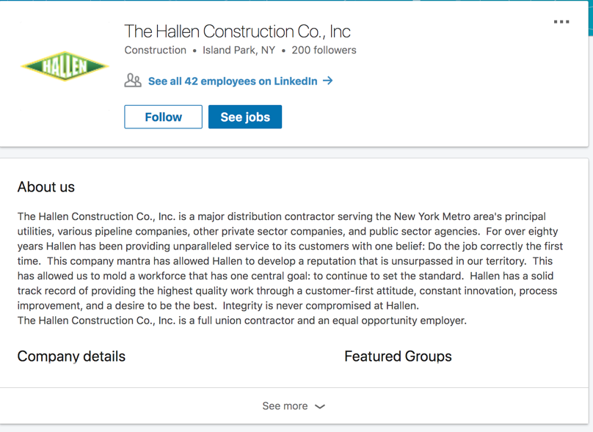
SOCIAL MEDIA:
OVERALL BEST PRACTICES FOR ENGAGING GEN Z AND MILLENNIALS
SUCCESSES: Reinforce Employment Brand
Some DCA member companies have a company page on LinkedIn.
EVEN BETTER IF:
Every company had a LinkedIn page that was frequently updated. Creating and maintaining a company page on LinkedIn is important to increase the perception of your company being a quality employer as well to as align with job postings and driving traffic to your employment opportunities.

Slide 41
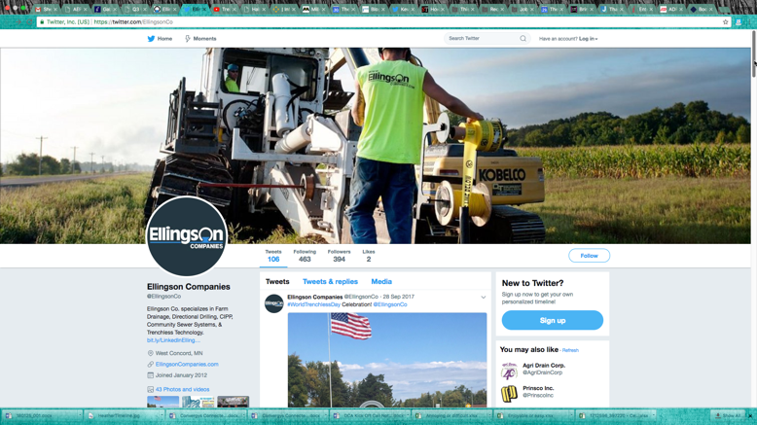
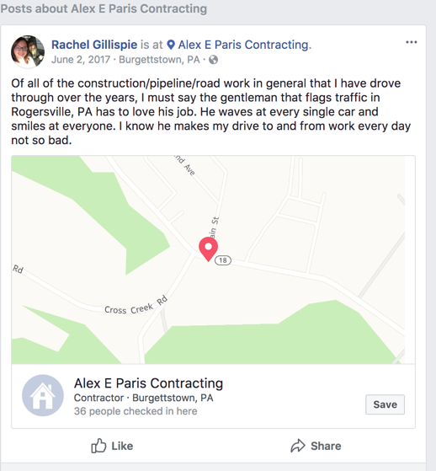
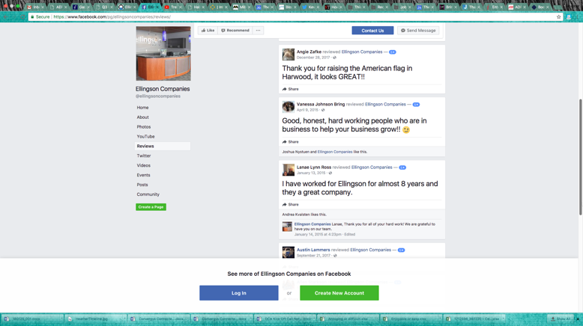
SOCIAL MEDIA:
OVERALL BEST PRACTICES FOR ENGAGING GEN Z AND MILLENNIALS
SUCCESSES: Brand Consistency
Some DCA member companies have Facebook pages, which is good because Facebook is used across generations—albeit less with Gen Z—and is effective for showcasing your company’s values and mission.
Some companies like Elligson have a solid foundation of different types of posts, stories and photos to touch both their community and convey to applicants what it’s like to work at the company.
Companies that don’t already have a Facebook page can start by creating one, and then add photos of diverse Millennial employees including women, career starters, and a variety of company mid-level leaders.
EVEN BETTER IF:
Promote and share the positive feedback that people leave on your page, like the comment on Alex E. Paris’ Facebook page.

Slide 42
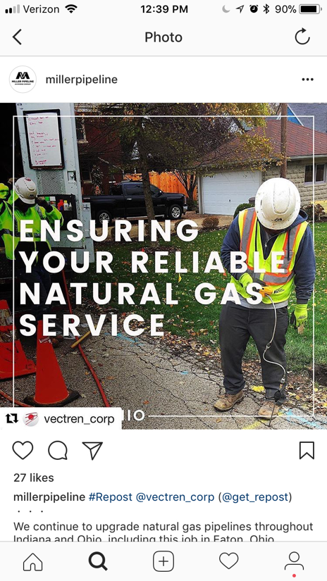
SOCIAL MEDIA:
OVERALL BEST PRACTICES FOR ENGAGING GEN Z AND MILLENNIALS
SUCCESSES: Diverse Images and Videos
One DCA member company we reviewed had an active Instagram account where they post employee pictures and events.
EVEN BETTER IF:
Every member company posted images, videos and content that show the company cares about its employees of every generation.

Slide 43
AREAS TO IMPROVE
CREATE SOCIAL MEDIA ACCOUNTS AND BE ACTIVE ON THEM
Many of the companies we reviewed did not have social media accounts or they had accounts with very little activity.
Unlocking the potential of social media is extremely important for your company and the industry.
If the industry is not on social media, it looks as if it and its employers are out of touch with the latest technology—which is not the case in the distribution contractors industry.
You want to fish where the fish are gathered and for Millennials and Gen Z that is on social media!

Slide 44
AREAS TO IMPROVE
CREATE SOCIAL MEDIA ACCOUNTS AND STAY ACTIVE ON THEM
These are the minimum social media channels (in order) where you should post at least weekly to drive engagement, excitement, trust, and job seeker traffic.
LinkedIn
Facebook
Instagram
Keep in mind that you can use the same basic content for all the channels. So you just write 1 post, but you slightly modify it to fit each platform’s requirements. In addition, all the posts will send people back to the same page on your website: your Careers page

Slide 45
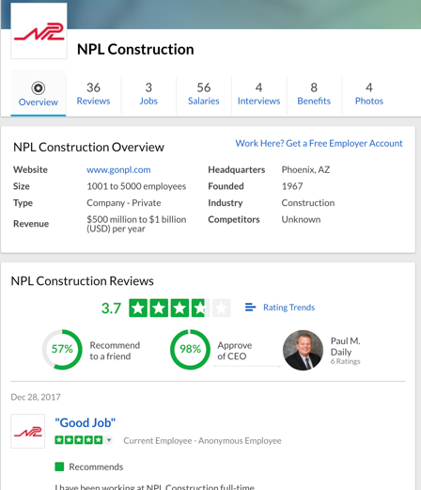
AREAS TO IMPROVE
MANAGE YOUR EMPLOYMENT REPUTATION ON SOCIAL MEDIA
Gen Z and Millennial job seekers are highly influenced by reviews posted by current or former employees
In our analysis, we found many DCA member companies had low ratings on GlassDoor.com. This is a highly influential employer rating website where employees write their evaluation of an employer.
It’s normal to not have a perfect score on GlassDoor.com, because disgruntled employees are often the most motivated to comment. However, now that you know the importance of GlassDoor.com, you can reach out to employees and leaders within your organization and ask them to write a rating about their experience.
Encouraging fans and champions of your company to write positive comments will offset negative comments over time and more accurately reflect the great experience and opportunity of working for you.
Infrasource: 2.5
Miller Pipeline: 2
NPL: 3.7
Hallen: N/A
Ellingson: 1.6
Q3: 2.5
Gabe’s: N/A
Alex E. Paris: no reviews

Slide 46
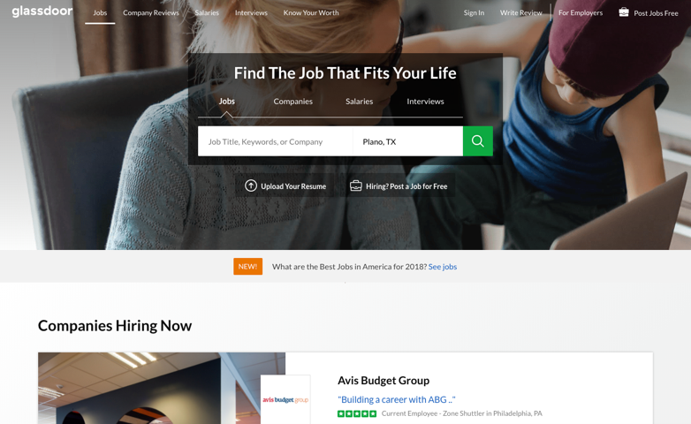
5 WAYS TO MANAGE
YOUR REPUTATION ON GLASSDOOR
Ask current employees who are fans and advocates to write about their experience.
Don’t argue with negative reviews.
Respond to negative reviews with empathy where appropriate.
Always clear your response with HR before posting.
Keep your profile updated so it accurately reflects your current work environment, branding, and mission.

Slide 47
SPECIFIC SOLUTIONS
ENGAGE YOUR COMPANY’S COMMUNITY
Engage your company’s community with content, pictures of employees in real life (particularly Gen Z and Millennials), and showcase how you are involved in the local community
Start Social Accounts
Start with LinkedIn and Facebook.
Add Instagram as a next step.
Whenever possible, use the same post on each platform but slightly adapt it for each platform’s requirements.
Attract Eyes by Making Content Engaging
Feature pictures and posts by your local community and by your company’s current employees, especially Employee of the Month, training, company awards, volunteer initiatives, and cultural touchpoints.
Organize a friendly competition to create sharable content across your company. Give awards and follow participants through a hashtag like: #MPLcareers
Highlight or feature employees during key moments that align with their career, such as promotions, recognition, and project completion.
Make a very small investment to promote posts on FB and Instagram ($20 per post) that are designed for the community to respond with comments.
Place Social Media icon links at the top of webpages and feature prominently on mobile
Prominent Social Media icon placement helps Gen Z and Millennials easily click to learn more about your company on their preferred social platform.
Remember, you don’t have to post every day or even every other day. Starting with once per week is fine; work up to twice per week to create a foundation you can build upon.

Slide 48
Social Media
GEN Z AND MILLENNIAL JOB SEEKER AND APPLICANT PATHWAY

Slide 49
SAMPLE CONSIDERATIONS
01
EMPLOYMENT BRAND PROMISE: How is your employment brand and employment promise communicated in job postings on these platforms to Millennials and Gen Z?
04
APPLICATION PROCESS: Is the application process quick and easy to start?
FOLLOW UP: Does the applicant get a thank you text or follow up message, sharing with them what to expect next in the applicant process?
02
JOB POSTINGS: Are jobs posted on social media sites? Are there images or videos to prompt them to apply?
05
START APPLICATION: Can a Gen Z or Millennial job seeker start their application process on social media platforms?
03

Slide 50
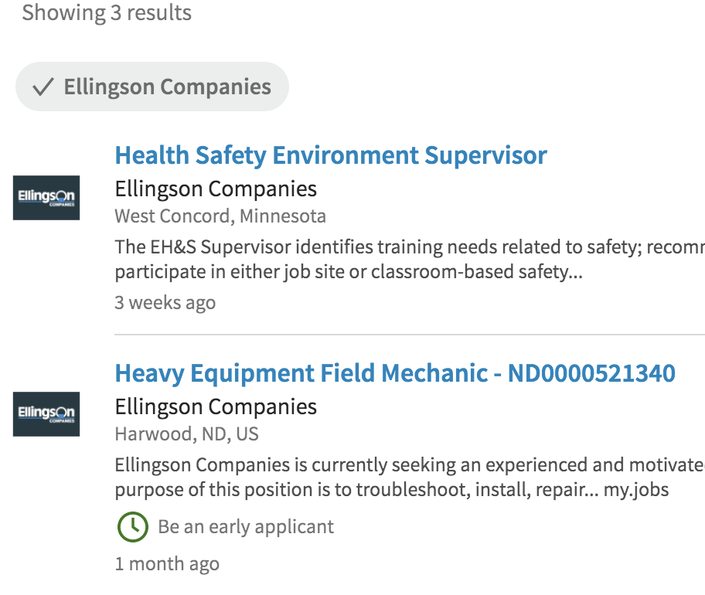
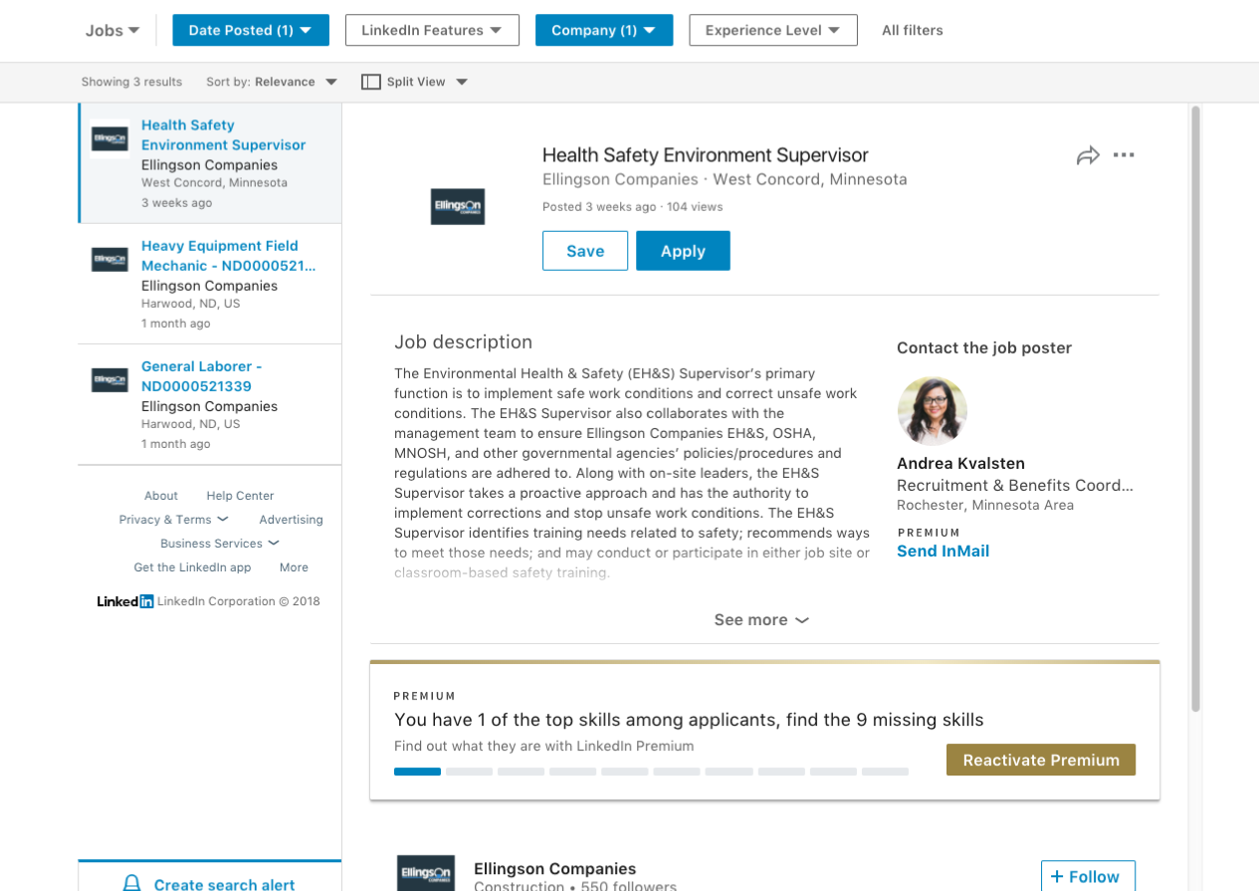
SOCIAL MEDIA:
GEN Z AND MILLENNIAL JOB SEEKER AND APPLICANT PATHWAY
SUCCESSES: Job Postings
Some DCA member companies have job postings on LinkedIn, which is the biggest social media platform for job seekers. It features resume-like profiles and professional networking groups.
EVEN BETTER IF:
The job seeker could apply directly through LinkedIn with their profile.

Slide 51
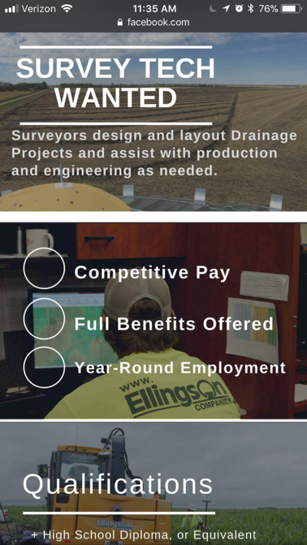
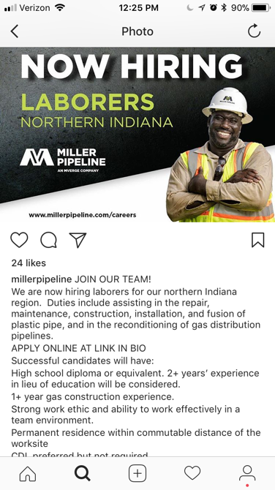
SOCIAL MEDIA:
GEN Z AND MILLENNIAL JOB SEEKER AND APPLICANT PATHWAY
SUCCESSES: Mobile Friendly Job Postings
A few DCA member companies had Job postings on Facebook and Instagram that used strong visuals to stand out in Gen Z and Millennial job seekers’ feeds.
EVEN BETTER IF:
There were more pictures of Gen Z and Millennials.

Slide 52
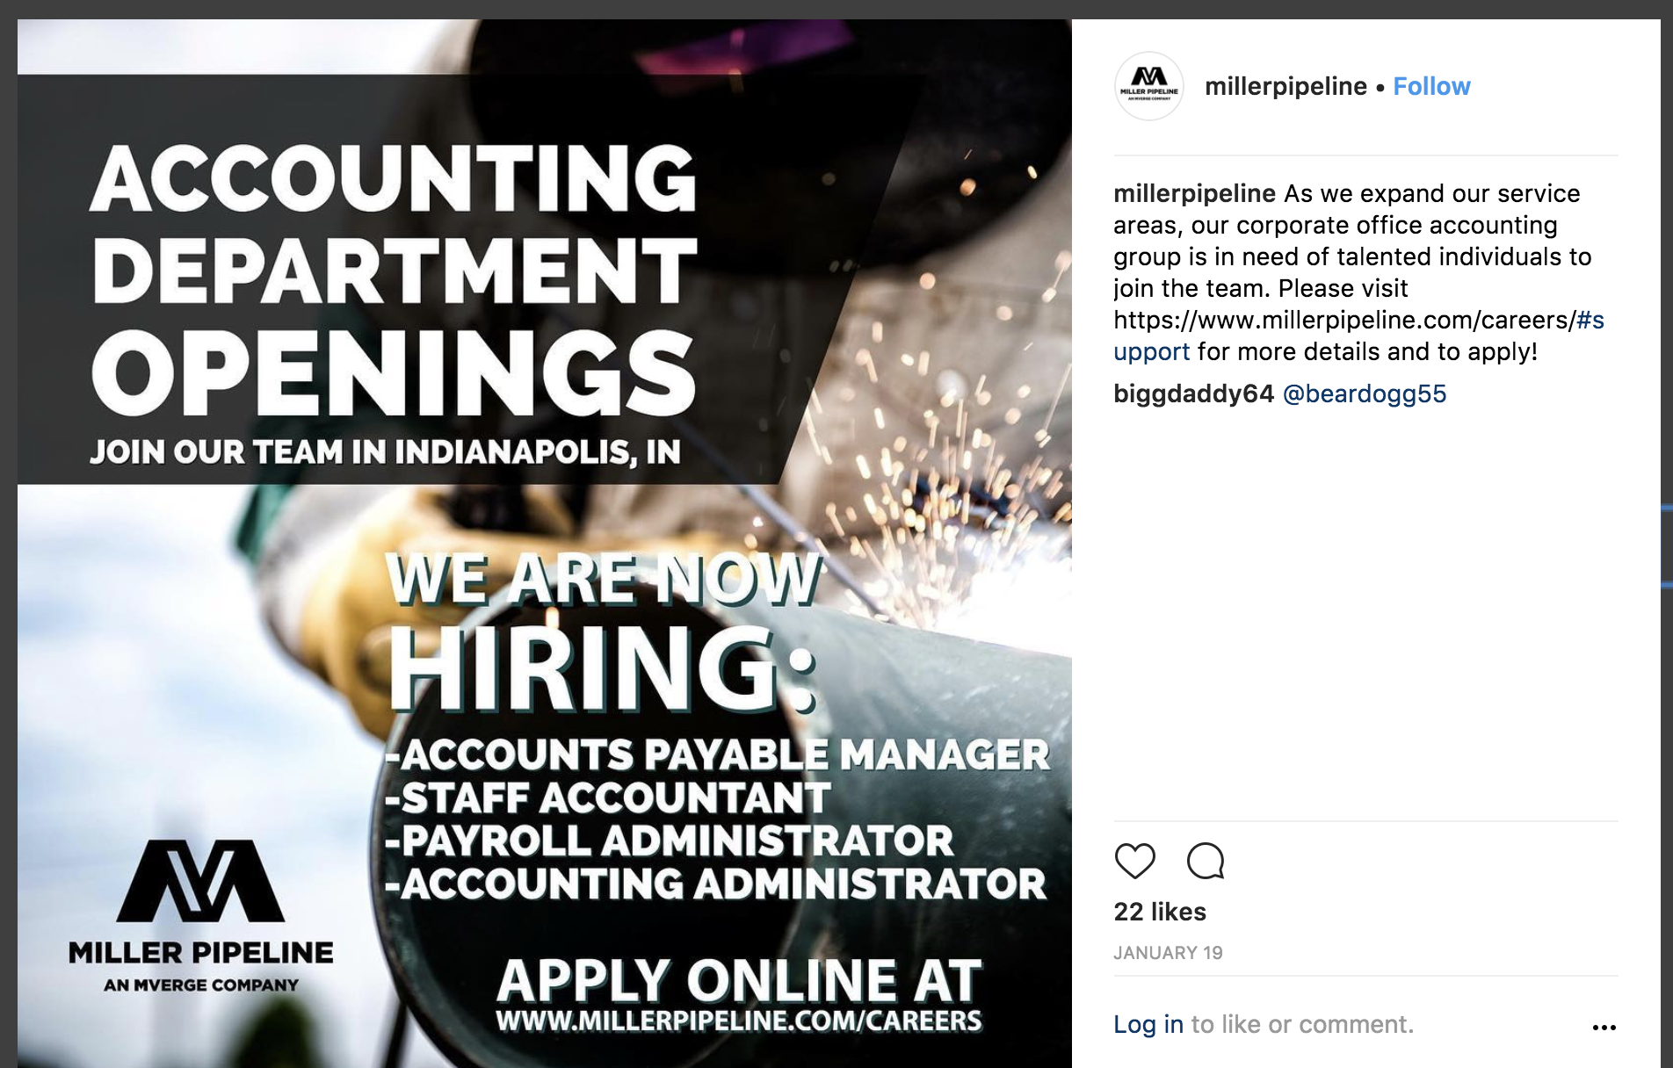
AREAS TO IMPROVE
WRITE CLEAR, COMPELLING JOB POSTINGS THAT ARE SOCIAL MEDIA FRIENDLY
Instead of a company perspective, consider taking a Gen Z or Millennial job applicant perspective.
For example, simply replace “ACCOUNTING DEPARTMENT OPENINGS”
with:
“ARE YOU A NUMBERS PERSON?”

Slide 53
SPECIFIC SOLUTIONS
Consistently message your unique employment brand on social platforms. Do this by specifically sharing what makes you different, humanizing stories of actual employees, and behind the scenes videos of daily life at your company.
Leverage Social Platforms to Connect with job seeking Gen Z and Millennials. Communicate the most powerful Gen Z and Millennial messages: stability, career advancement, training, and adventure. Use different hashtags or themes to help job seekers find these posts. Be sure to always use the same hashtag for your company, such as #JoinPSC, but also use broader hashtags designed to drive traffic to your posts: #jobs #careers #hiring etc.
Let individual stories shine through by posting a variety of media types. Use videos to let individual Gen Z and Millennial employees tell their own unique story of how your company helped them significantly in building their career. At minimum, post Gen Z and Millennial employee testimonials or reviews. If possible, let a “Gen Z’er” take over your account for a day—something you publicly promote—so they can share what they like about working for you and building a career at your company.

Slide 54
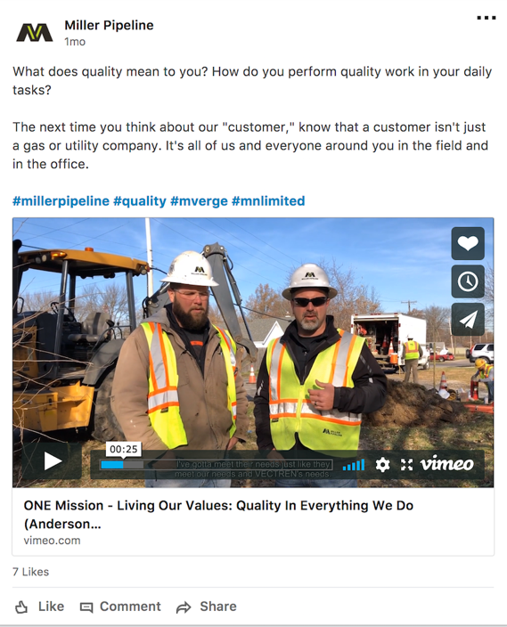
SPECIFIC SOLUTIONS
Amplify Your Message to Reach more Gen Z and Millennial Job Seekers
Amplify your job posting reach on each platform by investing a small amount ($20) per post. Even this small amount can increase views from a few dozen well into a few thousand per post.
Tie online and community involvement back to your company’s website by feeding top social media posts directly to your homepage. This will also help you generate more followers across platforms and keep content on your website new.
Help Job Seekers by Adding Employer Ratings and Reviews
Where appropriate, add ratings and reviews from employees to your company website. You don’t need this on every page but consider adding it to the Careers page.
Be active on Glassdoor.com to positively influence your employent brand reputation by encouraging positive employee reviews and empathetically responding to negative reviews when necessary.

Slide 55
TAKE-ACTION CONCLUSION
Now is the time to adapt to attract and hire Gen Z and Millennials within distribution contracting!
In fact, there will likely never be a better time as both generations are at the key life stage to identify and select employers with whom to build a career.
The industry must take new actions to unlock the best these two generations have to offer. This starts with optimizing your online recruiting and job application efforts to match what we know works best with these two generations of job seekers.
The following actions can be implemented immediately to drive recruiting and hiring gains across the industry.

Slide 56
3-Phase Recruiting Action Plan
FOR ATTRACTING MORE GEN Z AND MILLENNIAL JOB SEEKERS

Slide 57
PHASE I: 90 DAYS
3-PHASE RECRUITING ACTION PLAN RECOMMENDATIONS
Build a website if you don’t already have one (We all start somewhere :)
Test to see if you have a mobile-responsive website. Try at least 5 different mobile or smaller screen devices include tablets.
If your website is not mobile friendly, start taking steps to adapt it asap (ex: Wix).
Reposition homepage messaging to match Gen Z and Millennial job seeker employment hot buttons: Use current Gen Z and Millennial photos on website, employment collateral, and all social media channels. Make sure you have a video on your homepage!
Reposition or promote a JOIN OUR TEAM button on your homepage.
Start crafting your employment branding message: Why should job seekers apply now? What makes your company different or unique? What about this company makes me want to suggest my friends apply asap, too?
Make the beginning of the employment application process on mobile simple and easy (use a third-party job application solution if that is easiest for your company).

Slide 58
PHASE II: 180 DAYS
3-PHASE RECRUITING ACTION PLAN RECOMMENDATIONS
If you don’t have one already, create company accounts on LinkedIn and Facebook. Use a profile picture that shows real, diverse Millennial and Gen Z employees working at your company.
Launch your employment brand message on your website, social media accounts, printed collateral and email marketing so that applicants see the same message wherever they go to contact your company.
Post pictures on social media that reinforce your company’s values and employment brand. Applicants should be able to see your culture through the photos you post.
Make sure job seekers can easily find and apply through highlighted buttons and calls to action on your website and links on your social media.
Consider using a service like JobVite, Indeed.com or others to determine which recruiting channels work best both in terms of quantity and quality .

Slide 59
PHASE III: 365 DAYS OR MORE
3-PHASE RECRUITING ACTION PLAN RECOMMENDATIONS
Hire a social media marketer, or pay a college student, part-time employee or intern who has knowledge of the key social media platforms to help you post photos and job postings each week—ideally twice per week.
Create a company Instagram account. Start posting jobs using Gen Z and Millennial friendly wording. Remember that on Instagram the only link that is clickable is the one in your bio. Links in your post’s text are not clickable. Videos work best for overall views.
Regularly post company photos, employee testimonials and behind the scenes pictures of what it’s like to work at your company. Include links in every post on your company’s social media for a job seekers. Make sure it is easy to apply on mobile, too.

Slide 60
PHASE III: 365 DAYS OR MORE
3-PHASE RECRUITING ACTION PLAN RECOMMENDATIONS
Invest ad dollars to see where you can drive more engagement and job applications within a specific geography, such as within 100 miles of your office or primary work sites.
Continue to enhance your homepage and career pages to align with specific application goals. Consider building a landing page exclusively for job applicants so you can test different messages to see which drives the most job applications.
Consider creating a YouTube channel to influence Gen Z job seekers (95% use YouTube and half say they “can’t live without it”). Use videos that are 30 seconds or less with employees sharing what they like about working at your company—and what it’s like behind the scenes. Even better if you can showcase employees who started as a laborer and have been promoted to management positions.

Slide 61
Questions?
NEXT STEPS
Take Ground Monthly — Implement the First 90-day plan
Engage The Center — We can work directly with you for digital consulting or on-site training
Celebrate Successes! — It’s important to recognize this is a marathon and not a sprint.
SMALL GAINS TURN INTO BIG RECRUITING WINS OVER TIME!
Let’s answer them!

Slide 62
THANK YOU!
Denise Villa, CEO
Heather Watson, Behavior Designer
The Center for Generational Kinetics
Info@GenHQ.com | 512-259-6877
We are excited about our partnership with you and DCA to attract Gen Z and Millennials to your fantastic industry!

